Slide 1
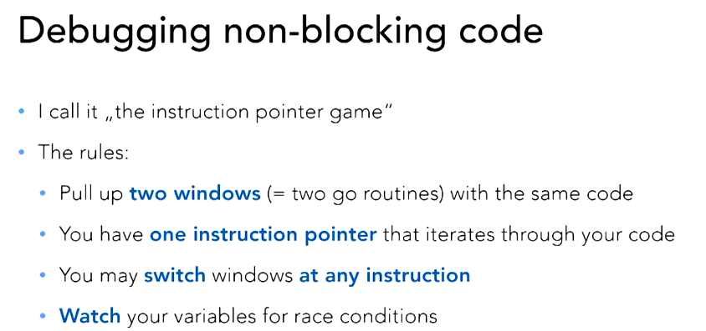
Ticket storage debugging

Slide 2
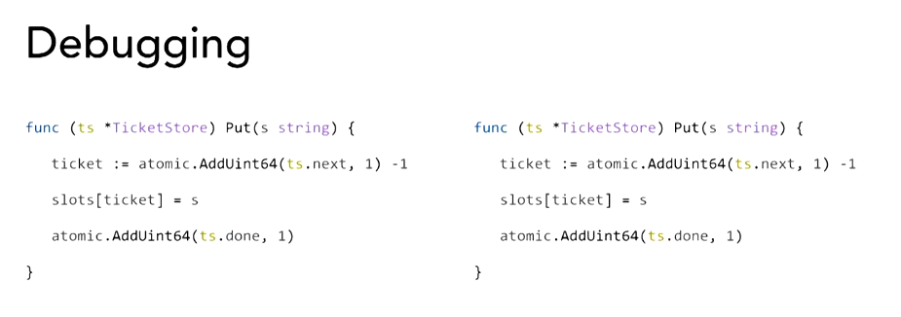
The code with a simple add instead of the cycle with runtime.Gosched()

Slide 3
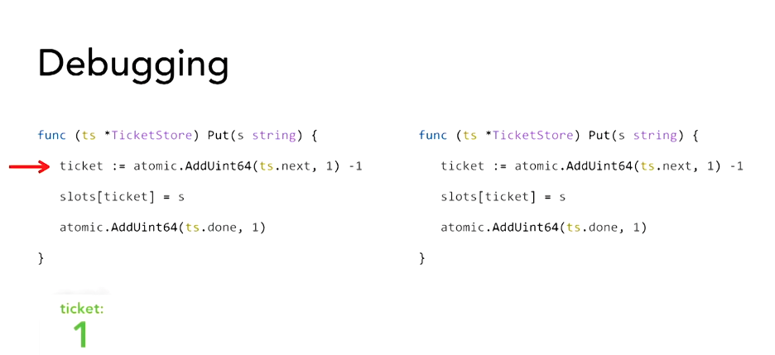
The code – iteration 1
We get the ticket number 1

Slide 4
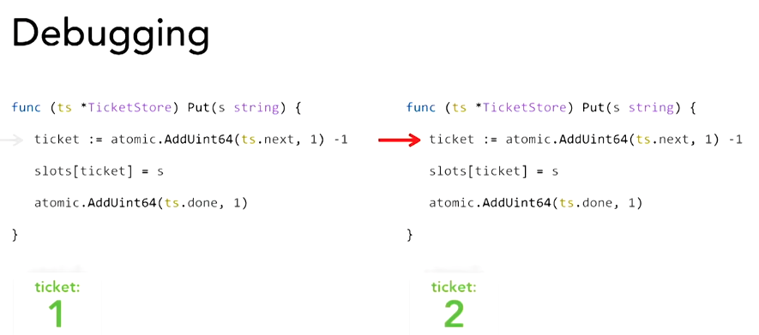
The code – iteration 2
We jump over to the next window and we get the ticket n. 2

Slide 5
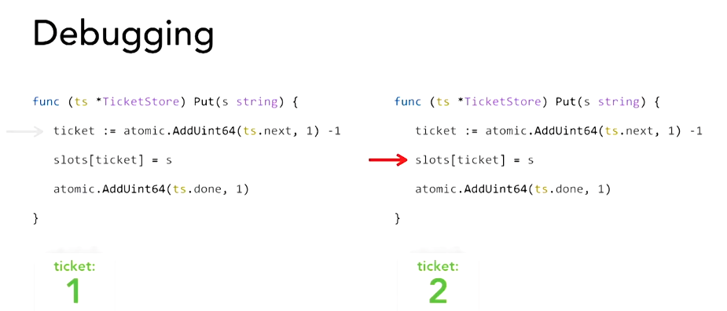
The code – iteration 3
We write to our slot and everything’s fine

Slide 6
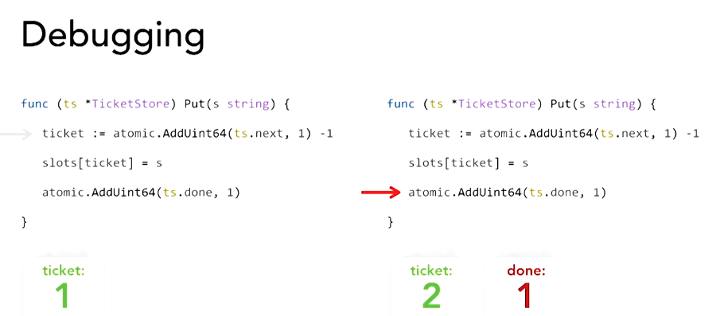
The code – iteration 4
We now increment the done and then we’re saying: index n. 1 is done … but index n. 1 is not done!

Slide 7
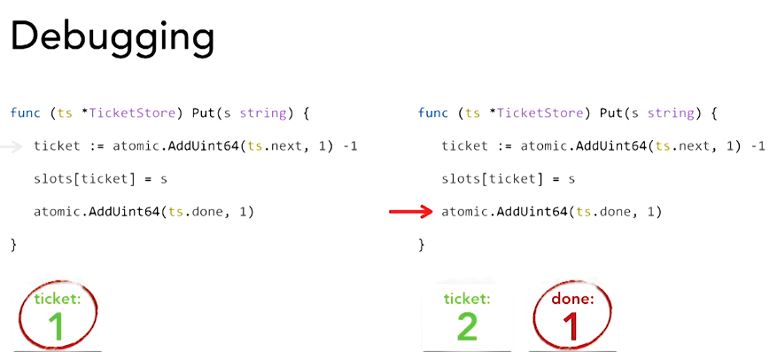
The code – iteration 5
Index n. 1 is not done because we haven’t written it yet. So this is our error. We actually have a race condition here

Slide 8
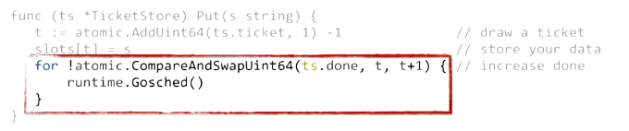
The code – the loop
This loop will essentially wait until the done variable is at the state of our tickets so we can increase it to have the ordered release
This is, so far, a common practice to handle atomic operations within multiple threads

